Slide 1

Medical Advisory Panel (MAP) Meeting
TA ONCO Update
To insert a wordmark:
Add (e.g. via drag and drop) your wordmark file (in RGB) to this slide (in alignment with our brand governance and architecture guidelines)
Change the size of the wordmark according to the height reference (magenta placeholder)
Select the “guides” in the navigation bar and move the wordmark to the right and top line (orange)
  Sally Chen, Jiaqi Lu | May 2025

Slide 2





WE PRIORITIZE OUR PORTFOLIO
… based on in-depth competitive scenario planning, allowing us to accelerate development of our leading assets
Pre-PoCP
post- PoCP
OneHP Priority
zongertinib Lead indication: 2L NSCLC
2L NSCLC
1L NSCLC
3L+ BC
2L BC
Adjuvant NSCLC
2025
Planned launch year
zongertinib
2L GC
obrixtamig
2L epNEC
1L epNEC
obrixtamig Lead indication: 2L epNEC
1L SCLC
2L SCLC
2027
ezabenlimab
CD137/FAP
GDP KRAS
Non-CDN STING FR
SIRPα NG
ALPG/CD3
ODC-IL12
KRAS^{multi} degrader
VSV-GP-GSDME-IL12
KISIMA-2
KRAS G12D FR
TRAILR2/CDH3
Anti-LAYN AB
VSV-GP
B7H6/CD3
Stop/
Park
Sustain
Continue
Sustain
Priority
Reallocation of resourcing to priority assets
Lean development via smart backloading and resource minimalization until inflection point
Keep speed and investments as planned until inflection point
Acceleration via significant frontloading and additional resourcing

Slide 3





2025 ONC Key Milestone Overview
today
2
US launch for Zongertinib in 2L NSCLC
Global milestones
1
US Sub. for Zongertinib in 1L NSCLC
RoFD for Obrixtamig in 1L SCLC
3
PoCP for VSV-GP OV (Melanoma)
RoFD for Zongertinib in Adjuvant NSCLC
RoFD for Obrixtamig in 2L SCLC
Beamion Lung-1 Cohort 2 TLR
Zongertinib – 1L NSCLC
JAN | FEB | MAR | APR | MAY | JUN | JUL | AUG | SEP | OCT | NOV | DEC
NDA Sub. for Zongertinib in 2L NSCLC
Dareon-Lung-1 CTA Sub.
Obrixtamig – 1L SCLC
NDA Sub. for Zongertinib in 1L NSCLC
China milestones
Dareon-Lung-2 CTA Sub.
Obrixtamig – 2L SCLC
Dareon-5 Type II Meeting Sub.
Obrixtamig – NEC
Ph1 Part 2 SIV B7H6 – CRC/GC
4
PhIb/II CTA Sub.
Systemic STING ago. FR – NSCLC
Ph1b 1st SIV
CD137/FAP – 1L HNSCC
SoD/PoCP/RoFD
Termination
TLR
Study start/ read-out
CTA/SIV
BTD/NDA
Termination
Milestone

Slide 4
ONC Portfolio Key Update – Late-Stage Assets
Asset Name (MoA) | Indication | China Approval (base case) | Update | Next Step
Zongertinib (HER2 TKI) | 2L NSCLC | Jan 2026 | CFDI & FDA GCP inspection accomplished in Apr Technical review by CDE was initiated in Jan 2025. 2nd rolling submissions (PK study report and PI update) in Mar CTP v 7.0 and local amendment submitted on 9 May, approval expected in Aug. DSUR submitted in May | Prepare for 3rd rolling submission (Updated 12months efficacy and safety data) in May based on cohort 1 updated data in May
 | 1L NSCLC | Jan 2027 | HA interaction request for Beamion LUNG-2 CTP amendment (v5.0) based on FDA feedback has been submitted in May Global: Beamion LUNG-2 Completed the Initial Recruitment (270 pts) with 65 CN patients (216% commitment) | Prepare for BTD application based on topline result of Beamion LUNG-1 cohort 2 in May, expect to sub. in Jun HA interaction regarding SAT for AA in Q3
 | Adjuvant NSCLC | 2032 | Team evaluated FDA feedback on Beamion LUNG-3 study and : Revisit Pre-IND meeting questions in China Evaluated possible impact on trial conduction based on FDA requests | To submit Pre-IND meeting request in May Trial preparation for Beamion LUNG-3
 | Pan-tumor | NA | Pan tumor team is approaching the strategy to global CEC for further development ( Single specific indications, tumor agnostic, etc) Protocol version 2.0 (with three new cohorts) was released, local team is expected to execute the new protocol by the end of May. CN: 5 subjects were screened ( 3 Salivary Gland Cancer , 1 Colorectal Cancer, 1 Cervical cancer) , 3 achieved PR. | New protocol execution and enroll new cohorts-related subjects
 | GC/BC | 2031 | Zongertinib value maximization strategy (3L+ BC, 2L BC, and 2L GC) was endorsed and protocol version 4.0 was released with new cohorts to explore new zongertinib based regimens in mBC. CN: 7 sites were initiated and totally 6 patients were treated with zongertinib. CTA amendment( new cohorts for breast cancer) application was submitted to CDE, expected to be approved by July 10,2025. | CTA amendment application approval by CDE.
Obrixtamig (DLL3/CD3 TcE) | 2L epNEC | Apr 2028 | HA interaction feedback is expected to receive in end of May 2025. | Initiate SIV of Dareon-5 in Aug 2025. Submit CTA of Dareon-Lung1 and Lung2 in Nov of 2025. Initiate SIV of both trials in Q2 of 2026.
 | 2L SCLC | Oct 2028 | RoFD has been shifted from Apr to Jul 2025 due to the immature early phase data. China team targets to submit preIND in Aug 2025.
 | 1L SCLC | Jul 2029
Brigimadlin (MDM2/p53 antago.) | Rollover study | NA | China team has submitted CTA on 25Apr 2025. But CDE reception officer inquired BI to clarify the application purpose, the trial should be with registration purpose . | Have received BL1 HA supportive feedback on 14May 2025. Will leverage the feedback to draft clarification and adjust application letter.
One HP Priority
TA Priority
Notes:
Beamion LUNG-3 CTA sub.

Slide 5

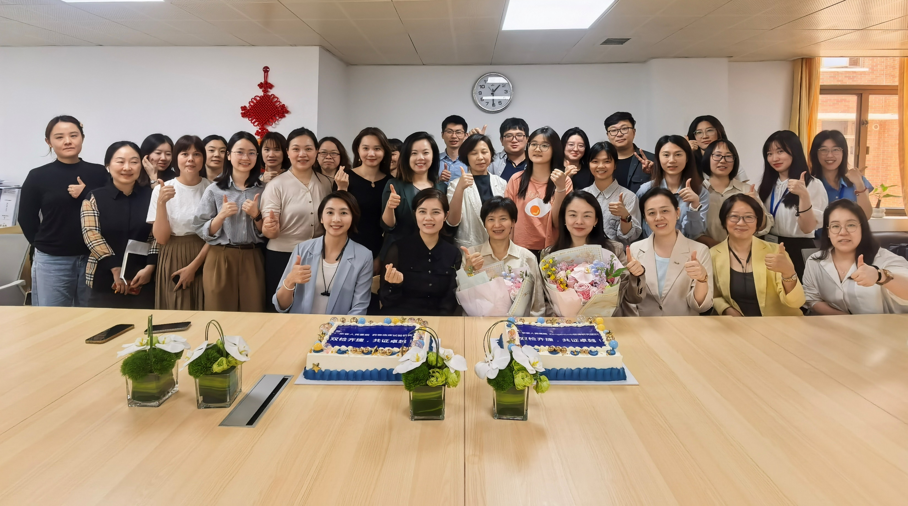

“双检齐捷，共证卓越”

Slide 6
ONC Portfolio Key Update – Early Assets
Asset Name (MoA) | Indication | China Approval (base case) | Update | Next Step
CD137/FAP | HNSCC | Jun 2031 | Global Ph1b (1463-0001) is expected to be a 8-month delay of the overall development timeline (PoCC: July 2026 → Mar 2027). 2 Chinese subjects were screened, the first subject was treated on May 6. | Speed up China recruitment
Systemic STING ago. FR | NSCLC | Sep 2032 | Global ph1 study is under the new dose level (DL7), which will take approximately additional 2-3 months (DEC: early of Jul 2025, PoPP: Jun 2025). No chance to catch up with the deadline of NMPA CTA pilot program (优化创新药临床试验审评审批试点工作方案), then go back to Standard pathway but keep close eyes on any new policy regarding the pilot CTA program. CTA preparation has kicked off in Mar 2025. | To prepare the CTA and site initiation → 1st SIV in Feb 2026.
KISIMA-02 | PDAC | Aug 2035 | It’s under the discussion of a China standalone Ph1 study after the trigger point of global POPP milestone in Dec 2025. | Follow up China integration plan with global team.
One HP Priority
TA Priority

Slide 7
Phase 1b Recruitment
Enrolled/ Consented | Screen Fails | In-Screening | Randomized/Treated
5 | 1 | 2 | 3

Slide 8
Timelines
First patient under the DL5/Part C Amendment (Sept 25)
PoPP prior to start of randomization
PoPP-Dec 25
RP2D–Feb 27
PoCC-Mar 29
2024
2025
2026
2027
2028
2029
Patients recruitment
End 2027-Beginning 2028
ATP150/
ATP 152
DL 5-B4
Part B
ATP 150/152
DL1 (Cohort B0) to DL4 (Cohort B3)
ATP162
safety
run-in
Part C
R
ATP162 (DL5)
Ph 3 start
ATP162 (DL2 or DL3 or DL4)
AMAL sponsor
BI sponsor
CRO: PFM – qualification ongoing
Start preparation
Dec 25
12-14m
FPI China
Feb 27
12m
Chinese plan
Feb 28
Last immune data Aug 28
From Global team

Slide 9
Thank You!

